Slide 1





BEVERAGES
DAILY SPECIAL
 | SMALL | Regular
COCACOLA DRINKS 0-380 Cal | 1.69 | 1.99
LEMONADE 165 Cal
BOTTLED WATER 0 Cal |  | 1.49
BOTTLED DRINK 10-230 Cal |  | 2.29
Chicken Teriyaki
640 Cal
6.69
6.39
SERVED WITH: • Mixed Vegetables • Steamed Rice
Extra Chicken
(4 oz.) 170Cal
1.69

Slide 2

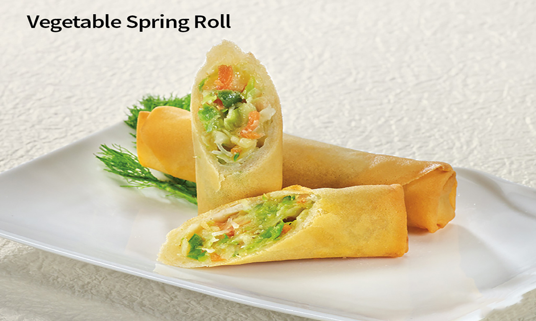
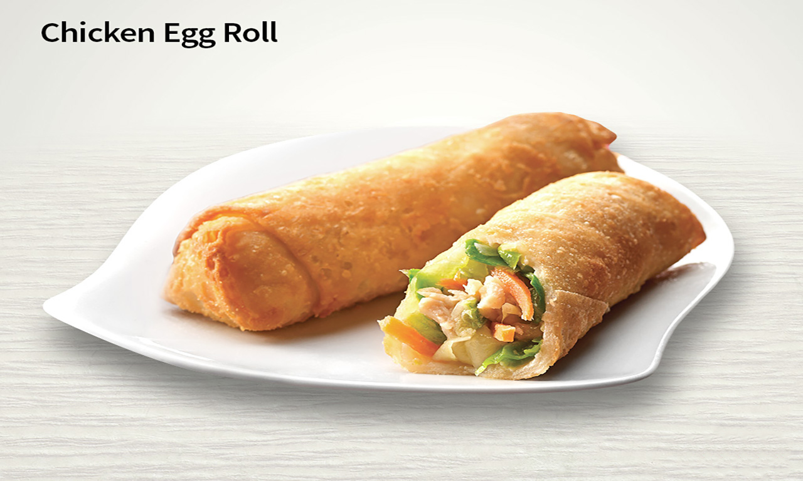
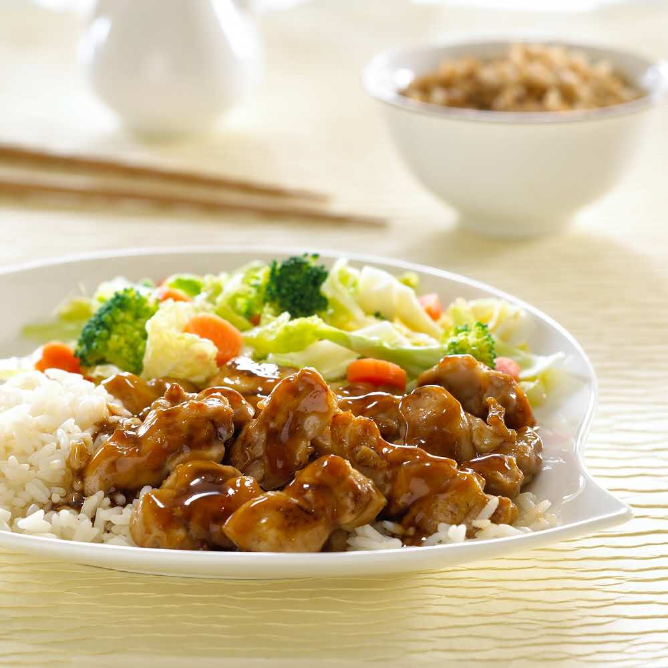
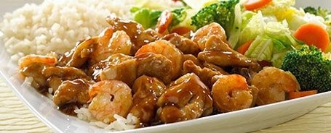
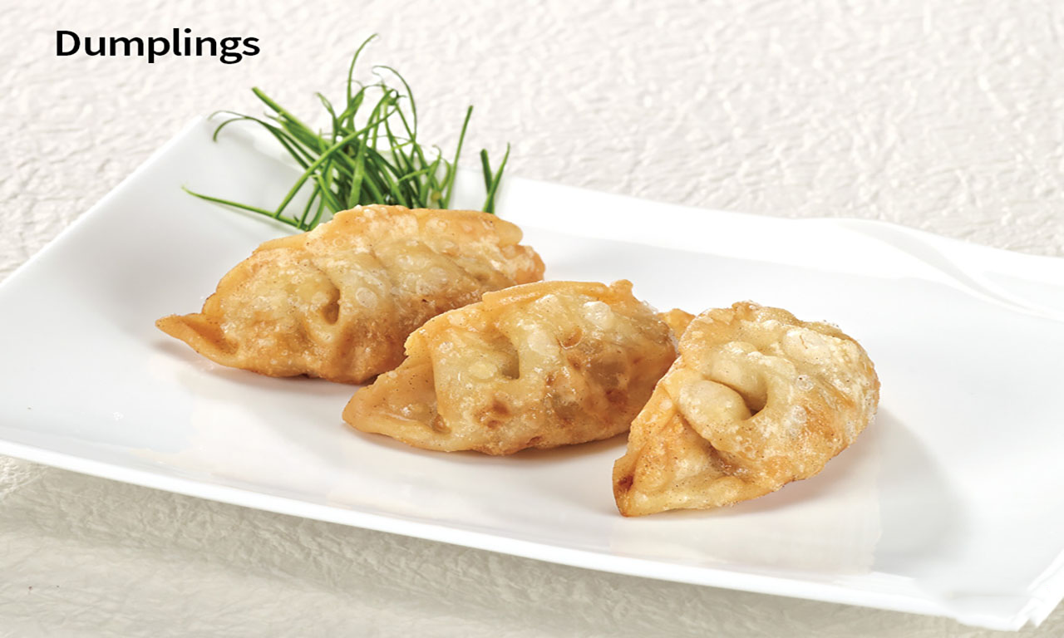
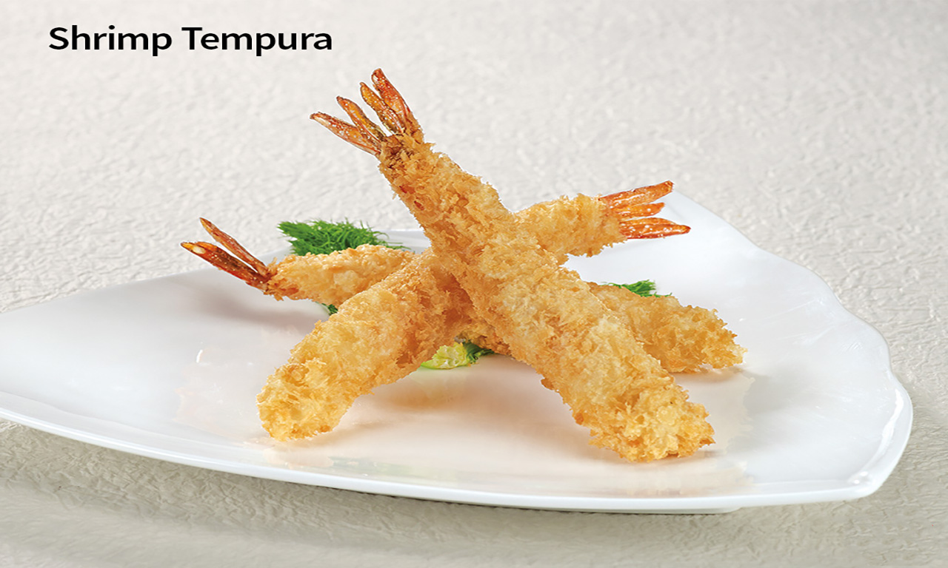
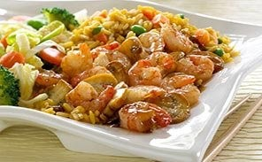
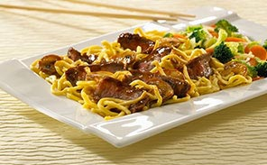
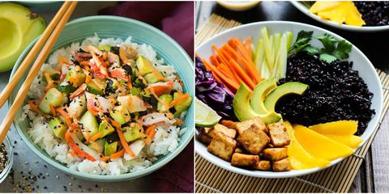
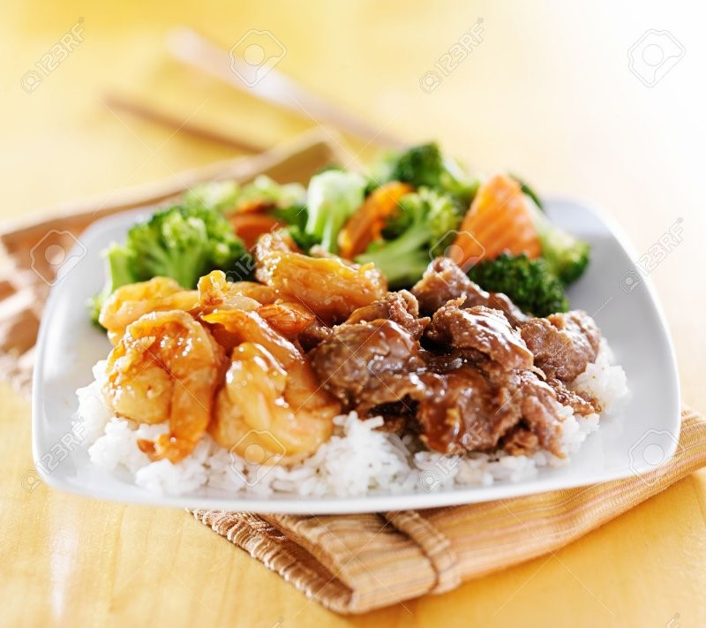


TERIYAKI
SIDE ORDERS
SERVED WITH: • Mixed Vegetables • Steamed Rice
1
2
3
4
D’LITE MEAL
5
SUBISTITUTE STEAMED RICE
FRIED 0.50
ADD 20 Cal
NOODLES 0.50
ADD 230 Cal

Slide 3
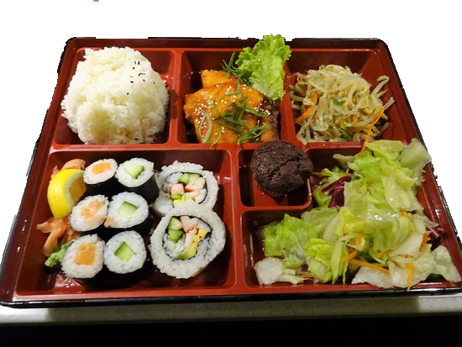
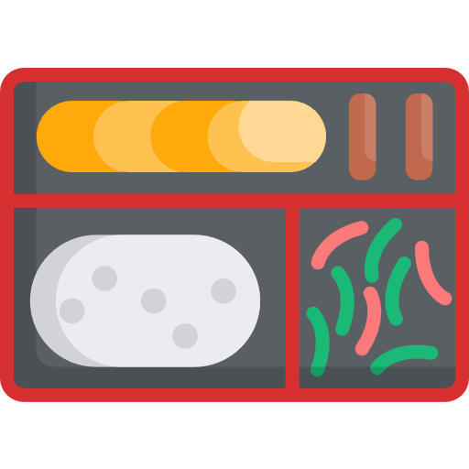


BENTO BOX
Chicken Bento | 930 Cal 8.19
Beef Bento | 810 Cal 8.99
Shrimp Bento | 750 Cal 9.49

